Slide 1
A Bengali Learning App for Foreigners
Submitted by Group 3

Slide 2

Motivation
300M
Native Speakers
7th
Most Spoken Language

Slide 3
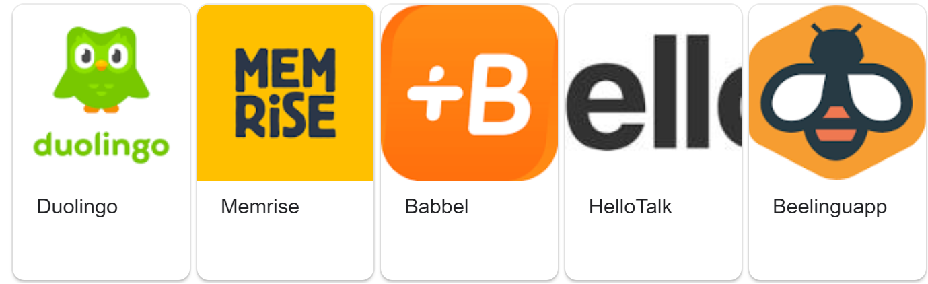

Popular Language Learning Apps
DOES NOT TEACH
BENGALI

Slide 4
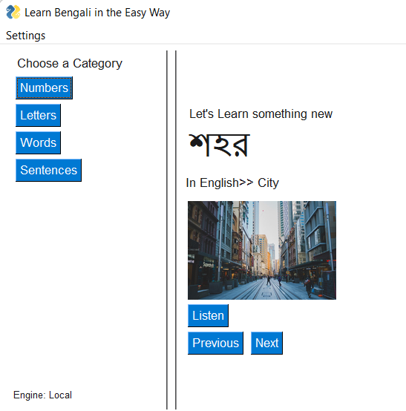
Self-paced
Intuitive
Easy to Follow

Slide 5
The User Interface
1
2
Categories
Bengali Word
English Translation
Image
Listen Button
Browse Buttons
3
4
5
6

Slide 6
Methodology
Google Engine
Local Engine
Speech-Recognizing Library of Python
Sends recorded audio to Google Server
Performs Speech Recognition via online
Speech Recognition Model trained by us.
Calls trained model of MATLAB from Python
Offline speech recognition

Slide 7
The Local Engine
Creating Training and Validation Data Store
Computing Auditory Spectrograms
Defining Neural Network Architecture
Training the Network
Evaluating the Trained Network
Saving the Trained Model for Future use
Deep Learning Based
Speech Command Detection

Slide 8
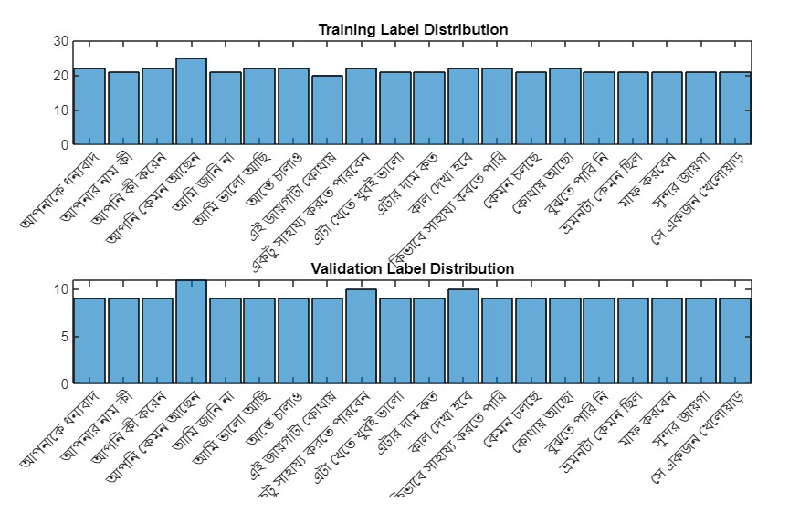
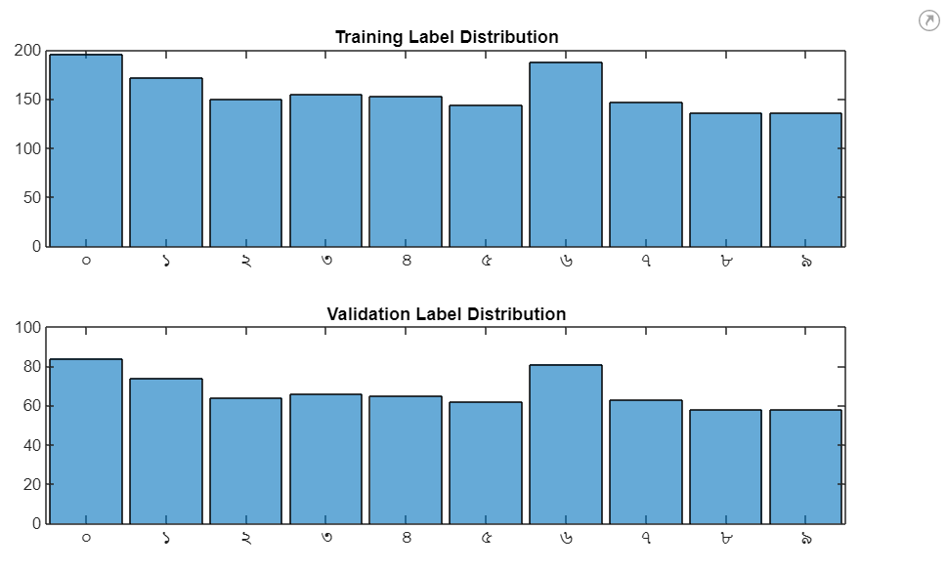
Dataset Creation
Total Number of Samples: 2555
Mainly Collected by Group Members
Digits datasets obtained from bengali.ai

Slide 9
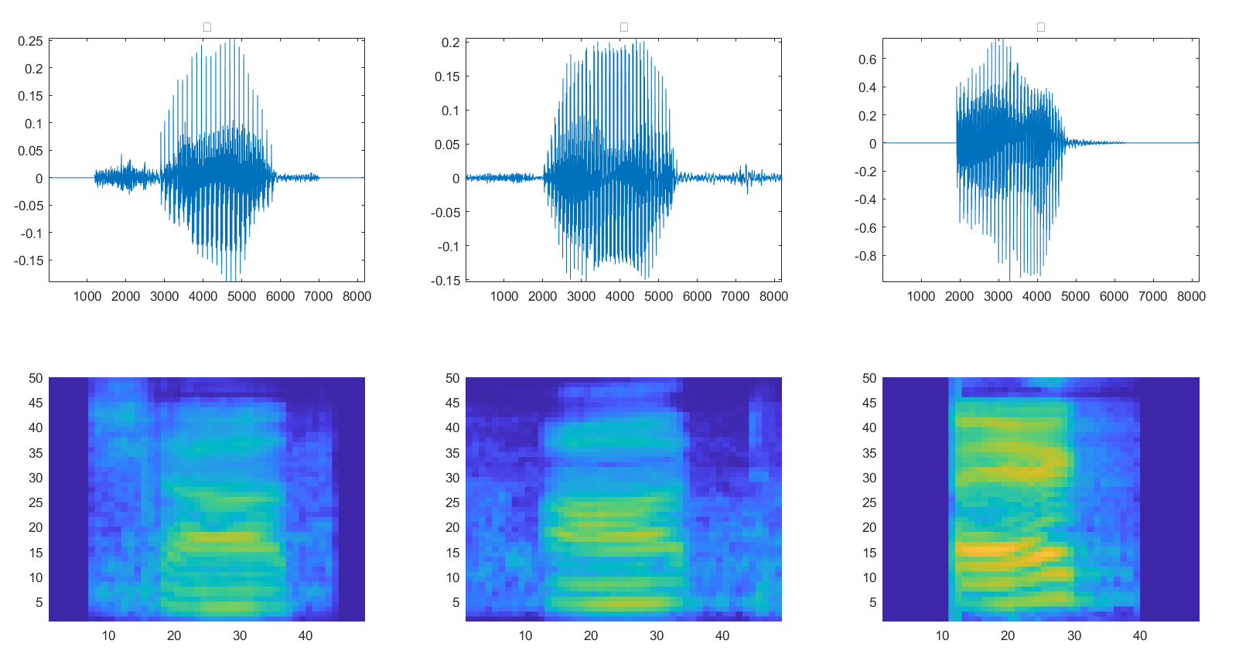
Feature Extraction
Bark
Spectrum

Slide 10
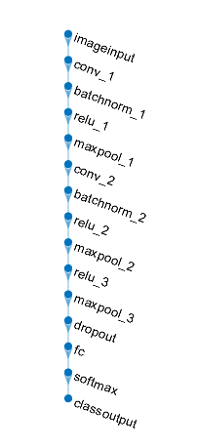
CNN Architecture

Slide 11
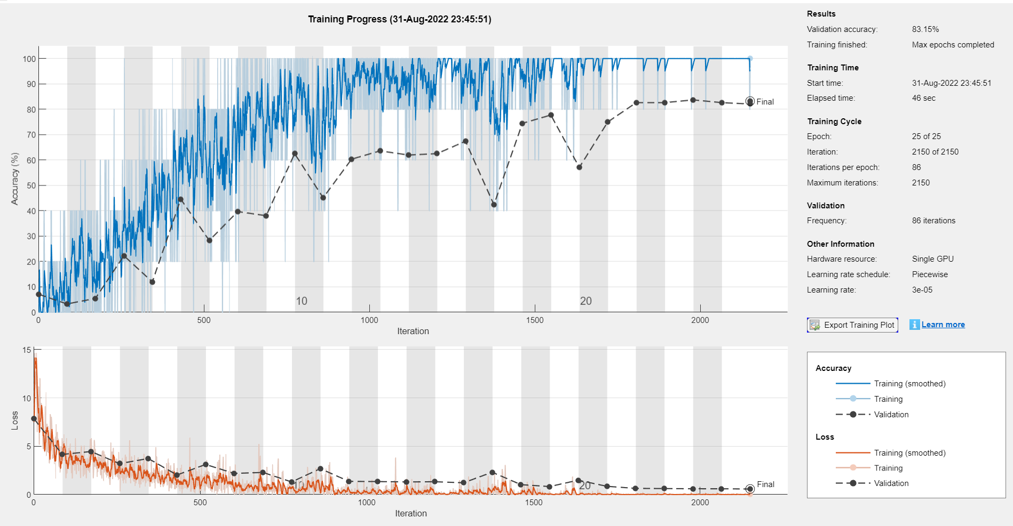
Training

Slide 12
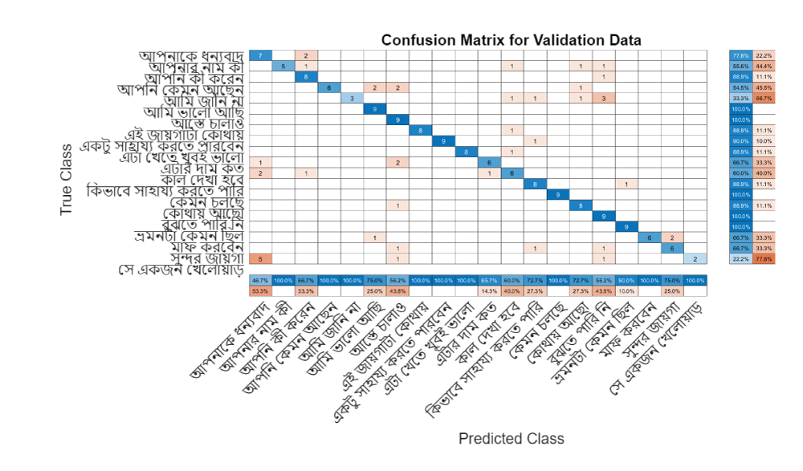
Results

Slide 13
Future Prospects
To train the model with more samples
Include subcategories (Easy, medium and Hard Words)
Play the recorded audio via offline
Expand the database of words and sentences

Slide 14
Thank You

